Slide 1
Introduction to Deep Learning Modeling in TensorFlow
Sheng Ming @9/29/2017

Slide 2
Agenda
Agenda
Quickly go over Youtube-8M Kaggle Competition
Introduction to TensorFlow
Titanic data TF implementation
Convolutional Neural Network (CNN)
Recurrent Neural Network (RNN) & Long Short-Term Memory (LSTM)

Slide 3
Youtube-8M Video Understanding Challenge
Team MSBA: Long Pei (phd), April Zeng, Judy Yan, Haylee Zhang, Yu Dong, Sheng Ming

Slide 4
Youtube-8M Video Understanding Challenge
“In this competition, you are challenged to develop classification algorithms which accurately assign video-level labels using the new and improved YT-8M V2 dataset. The dataset was created from over 7 million YouTube videos (450,000 hours of video) and includes video labels from a vocabulary of 4716 classes (3.4 labels/video on average). It also comes with pre-extracted audio & visual features from every second of video (3.2B feature vectors in total).”

Slide 5
Data we used (TFRecords format)
Video-Level Feature | Frame-Level Feature
One record per video | One record per second of video
Total size of 31GB | Total size of 1.71TB
Feature list: "video_id": unique id for the video, in train set it is a Youtube video id, and in test/validation they are anonymized "labels": list of labels of that video "mean_rgb": float array of length 1024 "mean_audio": float array of length 128 | Feature list: "video_id": unique id for the video, in train set it is a YouTube video id, and in test/validation they are anonymized. "labels": list of labels of that video. Each frame has "rgb": float array of length 1024, Each frame has "audio": float array of length 128

Slide 6
Computing resources we used
Google Cloud (GPU + Storage):
$300 free credit per new account
Powerful CML tools (gcloud/gsutil) to support training job and storage management
OOM (Out of Memory) Error occurred (could have been avoided with delicate resource allocation among GPUs and CPUs)
HPC Cluster (GPU/CPU):
Sufficient RAM to use CPU for training
Much slower (50~100 times) than comparable level GPU (why?)
GPU is designed to do large-scale mathematical computation!

Slide 7
Phases we underwent
Phase I: Do your research (60%)
Study baseline TF code and TF official website
Read papers to find good model, cost function, optimizer to use
Phase II: Tune and test (30%)
A lot of things to tune (#layers, #units, batch size, learning rate, learning rate decay, dropout rate, etc.)
Need to be careful to choose parameter set (time cost for testing)
Phase III: Create new model (10%)
Based on all the prior experience, figure out a way to ensemble the models that work best and make it even better

Slide 8
Models we applied
Baseline models:
Mixture of Expert (MOE) on video-level data https://www.cs.toronto.edu/~hinton/absps/hme.pdf
Long Short-Term Memory (LSTM) on frame-level data (will introduce later)
Best-performing model:
Ensemble model based on MOE structure
Better off baseline MOE model with 1/4 parameter size

Slide 9
Introduction to TensorFlow

Slide 10
What’s TensorFlow?
Open-sourced deep learning library from Google (Brain Team)
Especially good for training and implementing deep neural network (no XGBoost or any tree-based models!)
Not the only deep learning library (Torch, Keras, Caffe, etc.)
https://www.tensorflow.org/

Slide 11
What’s a tensor?
tensors are geometric objects that describe linear relations between geometric vectors, scalars, and other tensors
A rank-0 tensor is a scalar
A rank-1 tensor is a vector
A rank-2 tensor is a matrix
…
In TF, you can regard tensors as (symbolic handles of) multi-dimensional data arrays

Slide 12

tf.Graph()
“Dataflow is a common programming model for parallel computing. In a dataflow graph, the nodes represent units of computation, and the edges represent the data consumed or produced by a computation.”

Slide 13
Ops examples
Type | Ops examples
Arithmetic ops | Add, Sub, Mul, Div Less, Equal, …
Manipulative ops | Concat, Slice, Split, Shape, Reshape, Shuffle, …
Matrix computation ops | MatMul, MatrixInverse, MatrixDeterminant, …
Status ops | Variable, Assign, AssignAdd…
DNN related ops | SoftMax, Sigmoid, ReLU, Convolution2D, MaxPool, …
Saver ops | Save, Restore, …

Slide 14
tf.Session()
A Session object encapsulates the environment in which Operation objects are executed, and Tensor objects are evaluated. (talk to Ops & Tensors)
TF uses the tf.Session class to represent a connection between the client program---typically a Python program, although a similar interface is available in other languages---and the C++ runtime. (talk to C++ engine)
A tf.Session object provides access to devices in the local machine, and remote devices using the distributed TensorFlow runtime. (talk to devices)
It also caches information about your tf.Graph so that you can efficiently run the same computation multiple times. (enable ‘for loops’)

Slide 15
Titanic data TF implementation

Slide 16
Titanic Kaggle Challenge
https://www.kaggle.com/c/titanic
A practice case for new Kagglers to get familiar with Kaggle
“In this challenge, we ask you to complete the analysis of what sorts of people were likely to survive. In particular, we ask you to apply the tools of machine learning to predict which passengers survived the tragedy.”

Slide 17
Titanic Data
Variable | Definition | Type | Notes
survival | Survival | bool | 0 = No, 1 = Yes
pclass | Ticket class | int | 1 = Upper, 2 = Middle, 3 = Lower
sex | Sex | string
Age | Age in years | float | Age is fractional if less than 1. If the age is estimated, is it in the form of xx.5
sibsp | # of siblings / spouses aboard the Titanic | int
parch | # of parents / children aboard the Titanic | int
ticket | Ticket number | string
fare | Passenger fare | float
cabin | Cabin number | string
embarked | Port of Embarkation | string | C = Cherbourg, Q = Queenstown, S = Southampton

Slide 18
Titanic example TF implementation
Codes from: https://github.com/wangchen1ren/Titanic
Only for this tutorial use, please do not spread the code

Slide 19
Construct Dataflow Graph
Insert placeholders for tensors that will be always fed.
Declare all the variables
Build forward propagation flow
Declare cost(loss) function
Add optimizer for backpropagation

Slide 20
Build training session
Initialize all the variables for the 1st training: tf.global_variables_initializer().run()
Replace placeholders with real values: Session.run(fetches, feed_dict)
If node is a tensor, return value, if an ops, return None
Save and restore checkpoints: Saver.save() & Saver.restore()
Store summary data for TensorBoard visualization: tf.summary
Command to run TensorBoard: tensorboard --logdir=./logs

Slide 21

TF Learn
TFlearn is a modular and transparent deep learning library built on top of Tensorflow. It was designed to provide a higher-level API to TensorFlow in order to facilitate and speed-up experimentations, while remaining fully transparent and compatible with it.
Wrap Tensorflow in a Scikit-learn like interface (as easy to use as Keras)

Slide 22
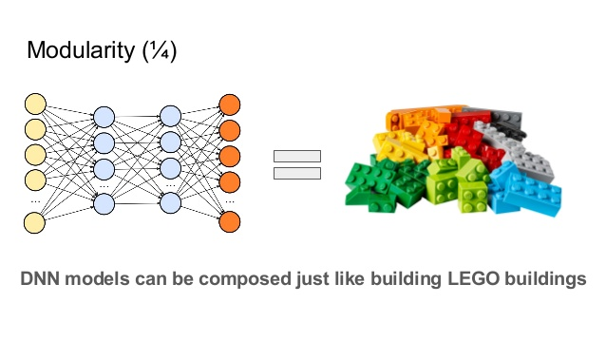
TF Learn version of the Titanic code
Only a few lines of codes to build sophisticated model and encapsulate all the training process in model.fit()
Just like playing the LEGO

Slide 23
Convolutional Neural Network (CNN)

Slide 24
What is deep learning?
”Deep learning is part of a broader family of machine learning methods based on learning data representations, as opposed to task-specific algorithms.” - Wiki
“Deep Learning is a subfield of machine learning concerned with algorithms inspired by the structure and function of the brain called artificial neural networks.” – Jason Brownlee
Get rid of feature engineering!

Slide 25

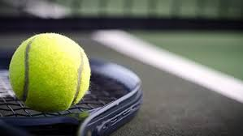

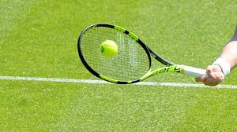
Basketball or tennis?
Machine learning | Deep learning
Samples: | Samples:
Ball1: Color = ’Red’, Size = 20 Ball2: Color = ‘Green’, Size = 1.05 Ball3: Color = ‘Green’, Size = 1.1 Ball4: Color = ‘Red’, Size = 19 … ...

Slide 26
What is Convolution?
“convolution is a mathematical operation on two functions (f and g); it produces a third function, that is typically viewed as a modified version of one of the original functions, giving the integral of the pointwise multiplication of the two functions as a function of the amount that one of the original functions is translated.” – Wiki
Extensive use in signal processing (not only image signal)

Slide 27
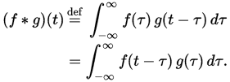
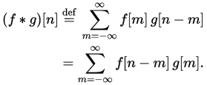
Continuous and Discrete Convolution
Continuous convolution:
Discrete convolution:

Slide 28
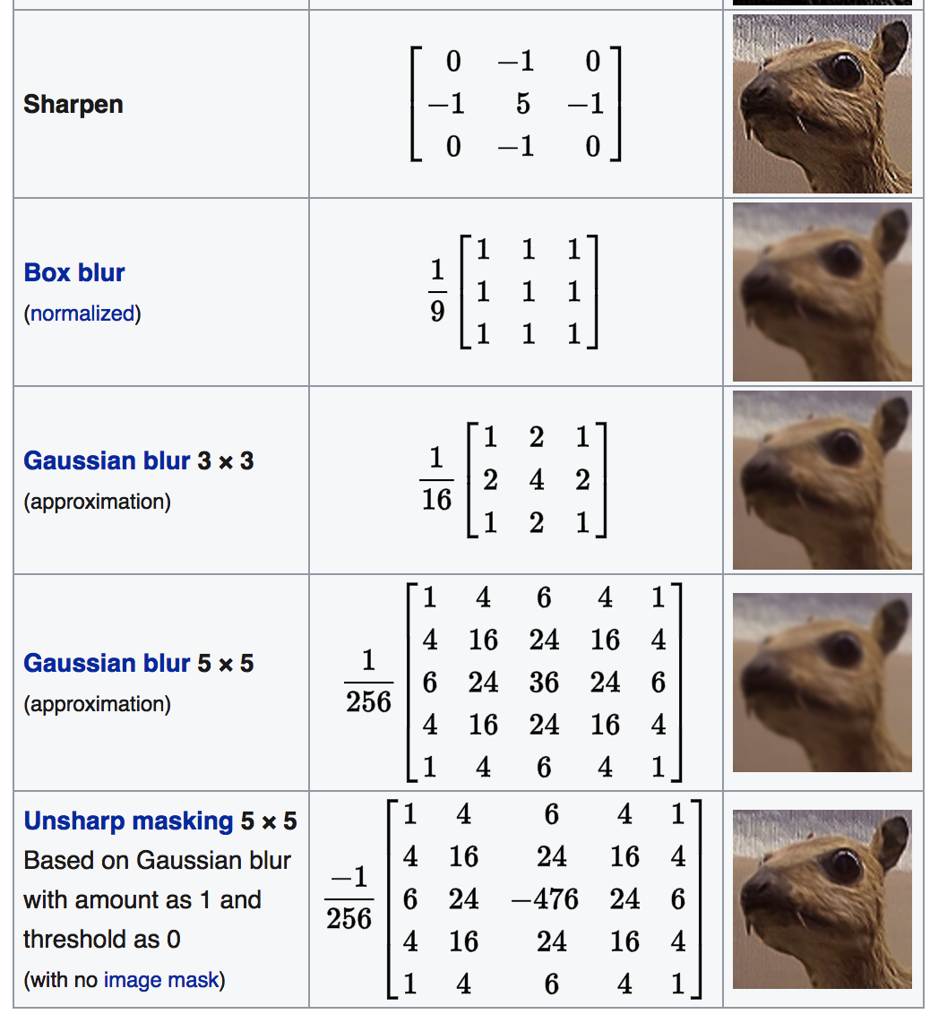

Convolution Kernel

Slide 29
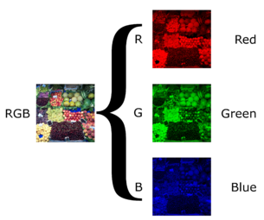
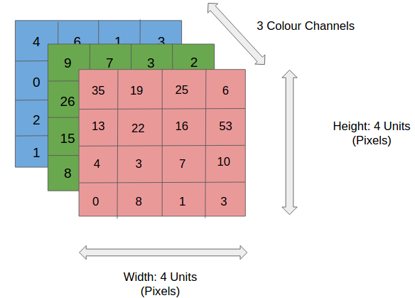
How images are stored in the computer

Slide 30
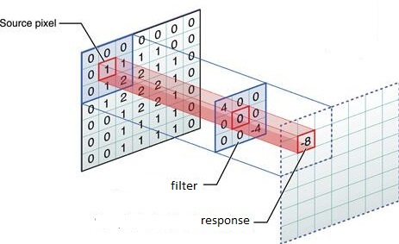
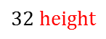
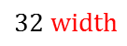
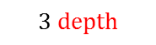
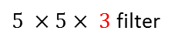
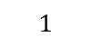
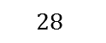
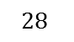
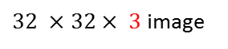
Convolution Layer
Filters always extend the full depth of the input volume
$32 ×32× 3$ image
feature map
32 x 32 x 3 image
5 x 5 x 3 filter
32 x 32 x 3 image
5 x 5 x 3 filter
$5 ×5× 3$ filter
$$32 height$$
$$28$$
$$28$$
$$32 width$$
Convolve the filter with the image
i.e., slide over the image spatially, computing inner products
$$1$$
$$3 depth$$

Slide 31
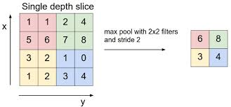
Pooling Layer
Max pooling, average pooling, etc. (translation invariant)

Slide 32
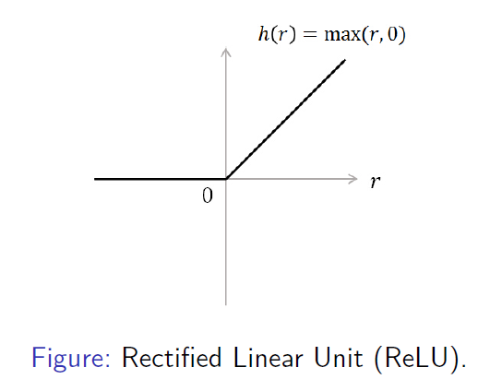
ReLU Activation
To avoid vanishing gradient in backpropagation

Slide 33
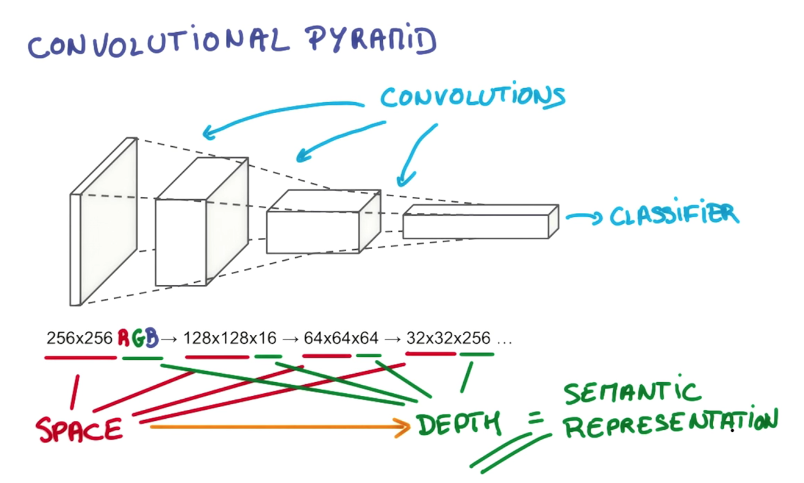
Convolutional Neural Network

Slide 34
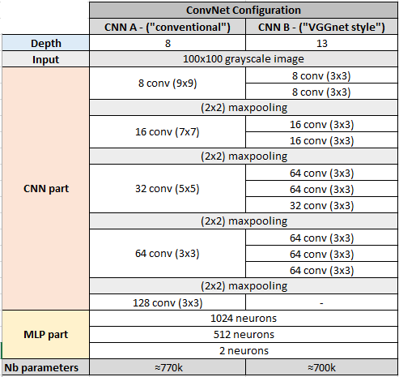
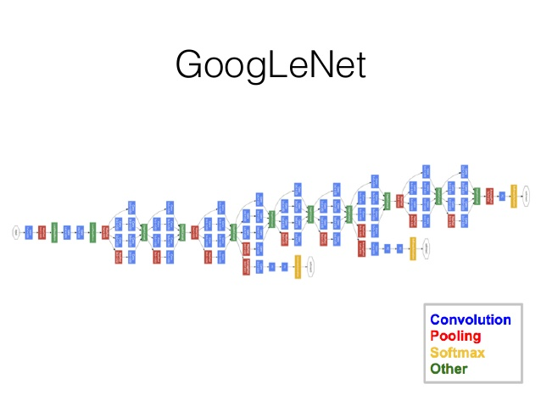
Classic CNN models
AlexNet (2012)
VGGNet (2014)
GoogLeNet (2014)

Slide 35
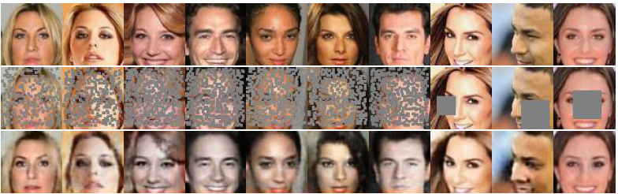
What CNN can do?
Learning from incomplete data

Slide 36
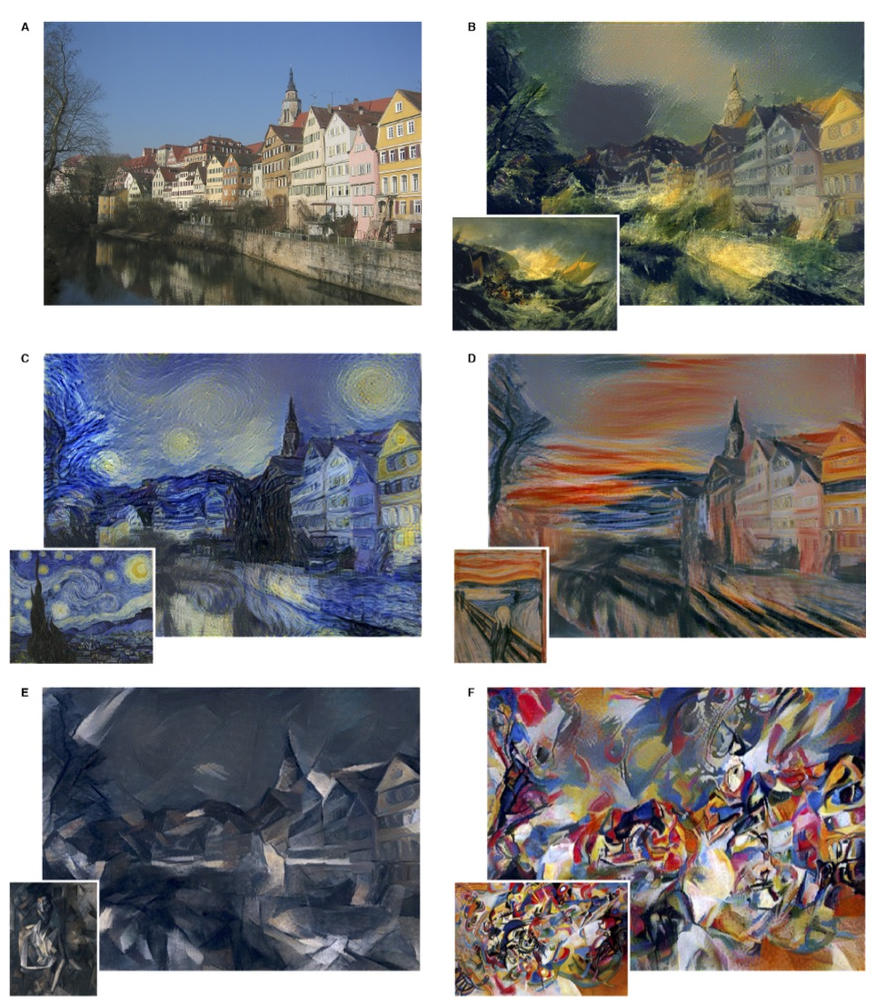
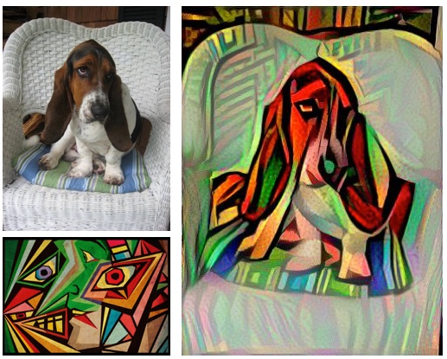
What CNN can do?
Generate stylish content

Slide 37
Recurrent Neural Network (RNN) & Long Short – term Memory (LSTM)

Slide 38
Build a robot to take TOEFL instead of you
It needs to be good at:
Listen: Speech to Text
Speak: Text to Speech
Read: Text Understanding
Write: Text Generation
Apparently, CNN cannot fulfill these tasks
However, a collaboration of linguistic model, acoustic model and other deep neural networks can (maybe a 70-80 score possible?)

Slide 39

Recurrent Neural Network (RNN)
A neural network that has memory (capture sequential pattern)

Slide 40
RNN is easy to forget…
All parameters are shared among all time steps (U, W, V)
If W_{ij} = 0.95, what’s W_{ij}¹⁰⁰ ? Parameter matrix —> 0
What’s the name of your childhood best friend?
Need a model to keep long-term memory

Slide 41

LSTM
Add three ‘gates’ to RNN cells (input gate, output gate and forget gate) to help keep long-term memory

Slide 42


Forget gate & input gate
Forget Gate
Input Gate

Slide 43


Update long-term memory & output gate
Update
memory cell
Output
gate

Slide 44
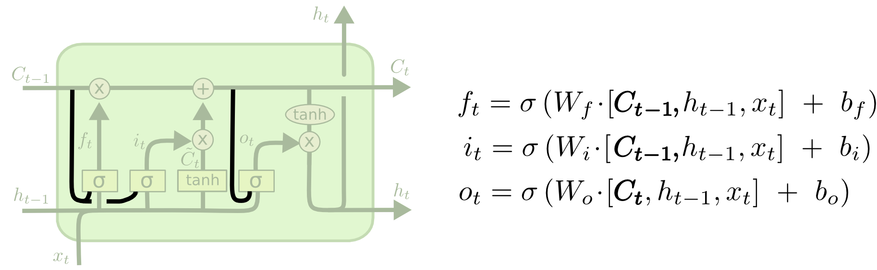

Some variants of standard LSTM cell
Lstm cell with peephole connection
Gated Recurrent Unit (GRU)

Slide 45
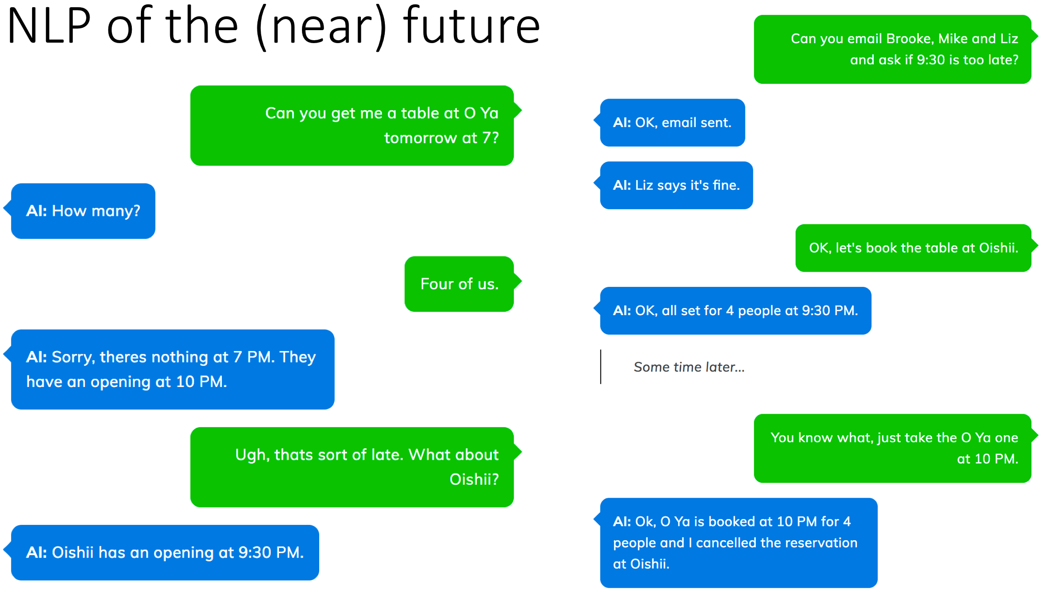
What about a life like this…

Slide 46
What RNN can do?
Text Understanding (text classification, sentiment analysis)
Text Generation (machine translation)
AI (Chatbot, Query-Answer System, Dialogue System)

Slide 47
Last but not least (parameter tuning)
Activation function (vanishing gradient)
Cost(loss) function
Optimizer algorithms
Dropout/early stop (avoid overfitting)
# of hidden layers/cells (underfitting/overfitting/vanishing gradient)
Learning rate/learning decay rate
Batch size (trade-off)

Slide 48
Thank you!

